Slide 1

WAY TO ENTERPRISE
Java Basics
VTI ACADEMY
Author: duy.nguyenngoc1@vti.com.vn
March 2020

Slide 2
Agenda
Debug
Handling Exception
Assignments
Copyright © VTI Academy All Rights Reserved

Slide 3
Debug
Breakpoint
Debug mode
Expression
Variable

Slide 4
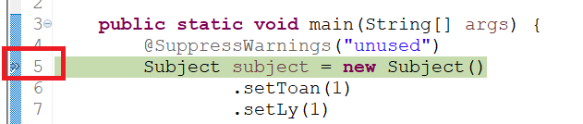
Breakpoint

Slide 5
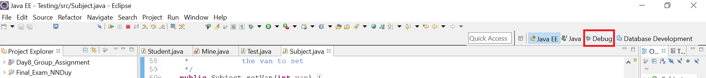
Debug Mode
Step into (F5)
Step return (F7)
Step over (F6)
Resume (F8)
Stop (Ctrl + F2)
Debug Mode (Alt + Shift + D + J)

Slide 6
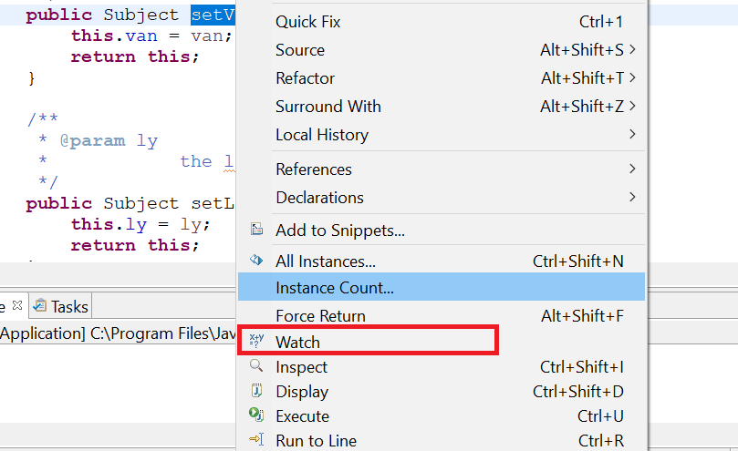
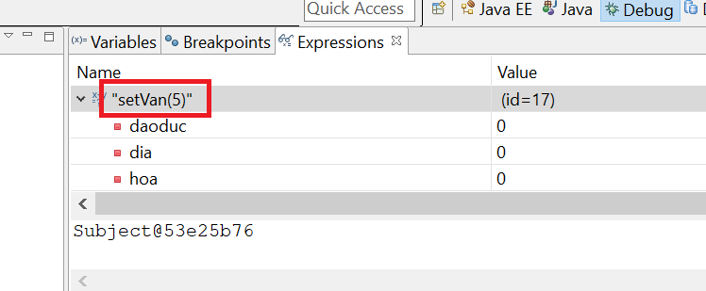
Expression

Slide 7
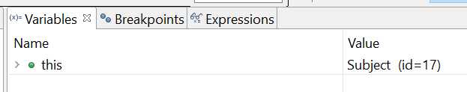
Variable

Slide 8
Handling Exception
Catching
Compile error
Logical error
Common Exception
ArrayIndexOutOfBoundException
ArithmeticException
NullPointerException

Slide 9
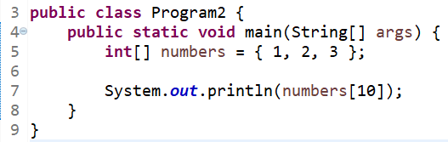
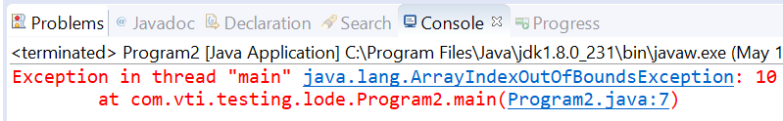
ArrayIndexOutOfBoundException

Slide 10
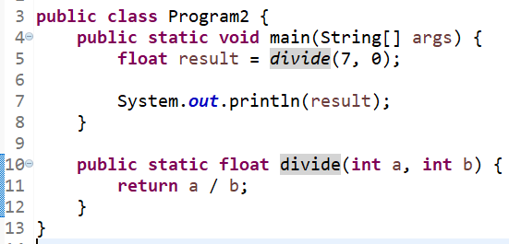
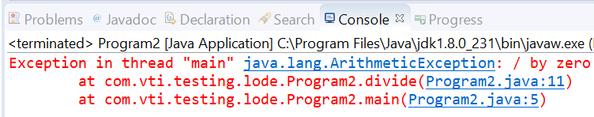
ArithmeticException

Slide 11
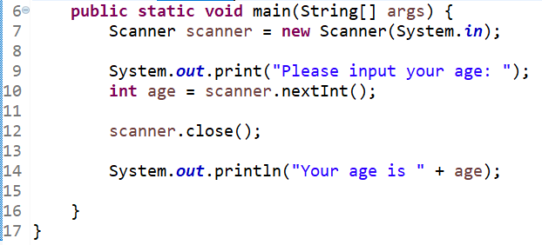
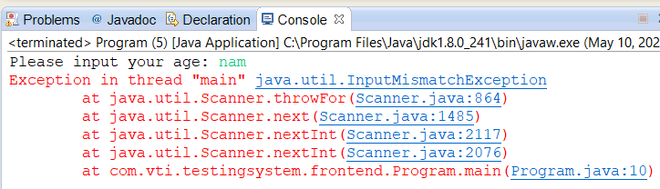
InputMismatchException

Slide 12
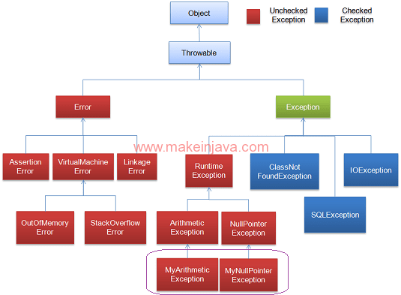
Exception

Slide 13
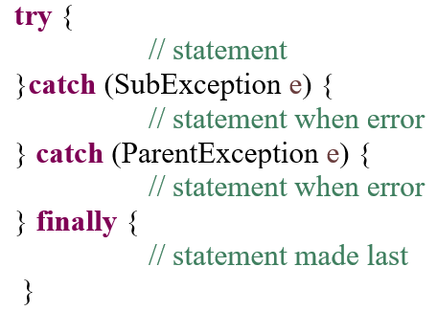
Syntax

Slide 14
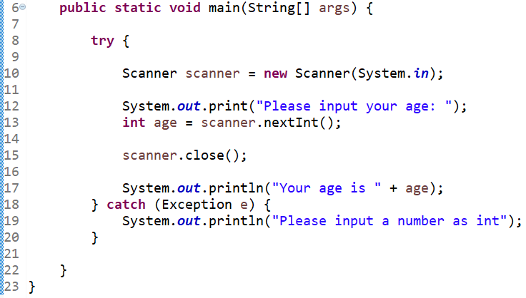
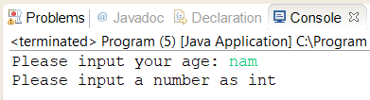
Example 1

Slide 15
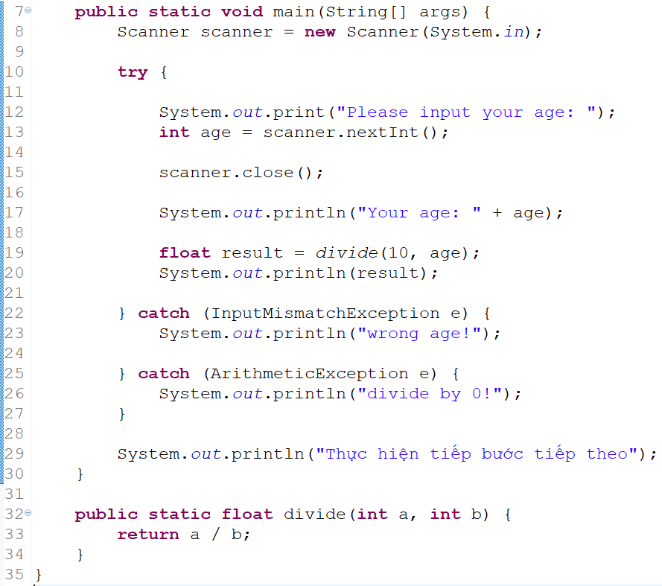
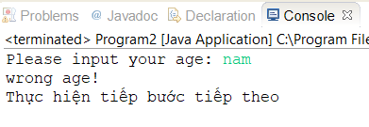
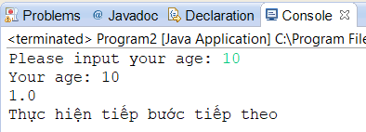
Example 2

Slide 16
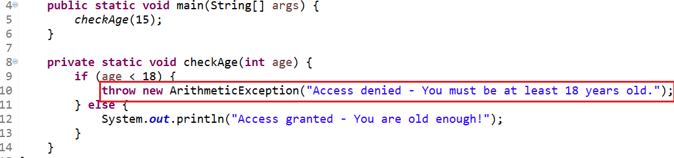
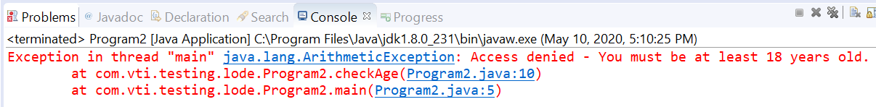
Throw & Throws

Slide 17
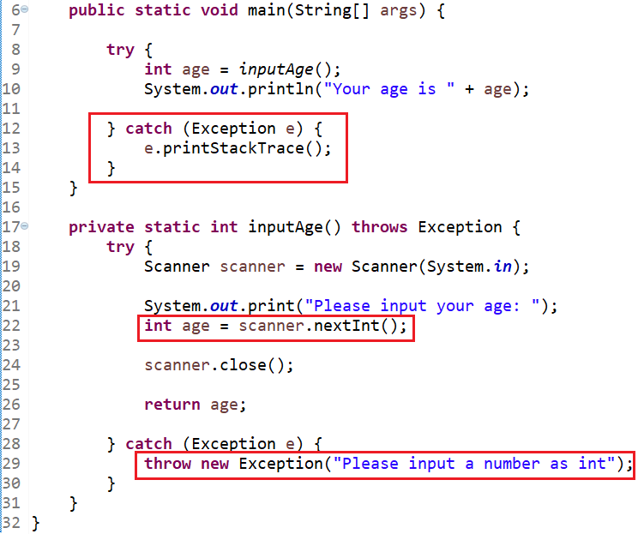
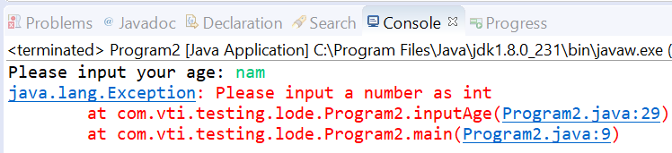
Example 1

Slide 18
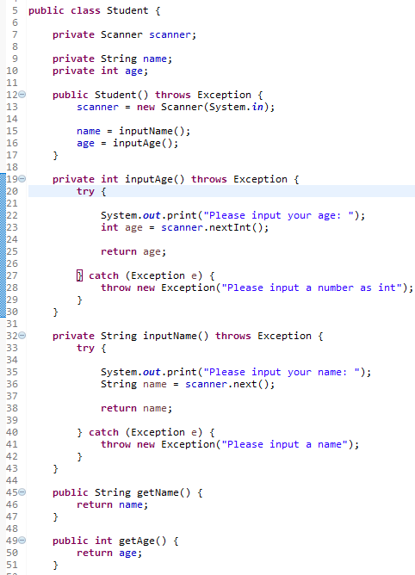
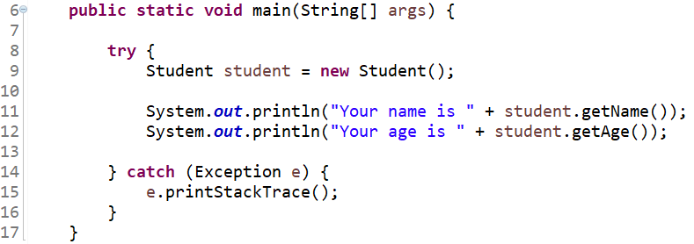
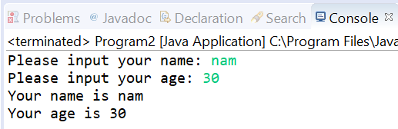
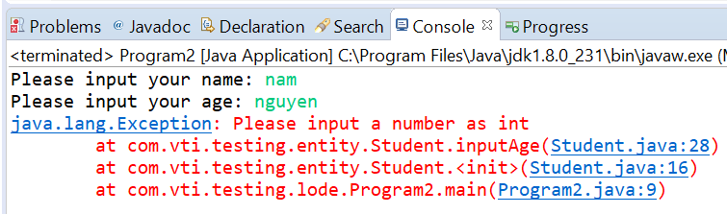
Example 2

Slide 19
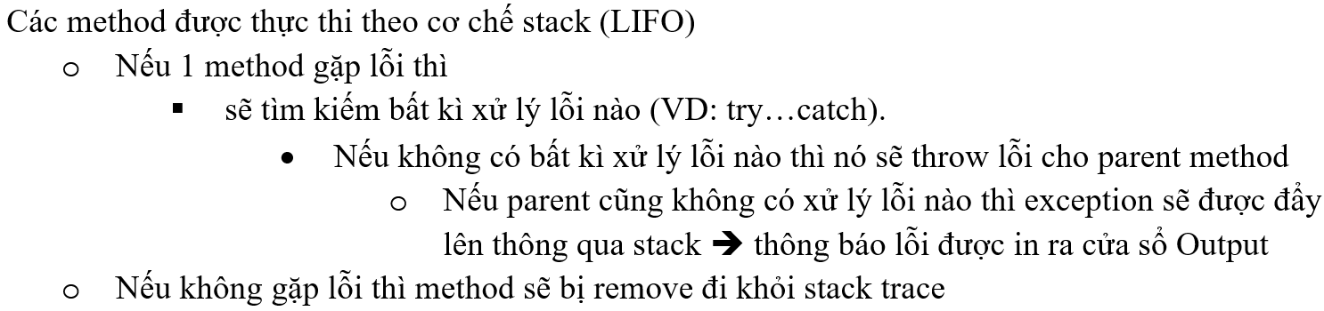
Stack Trace

Slide 20
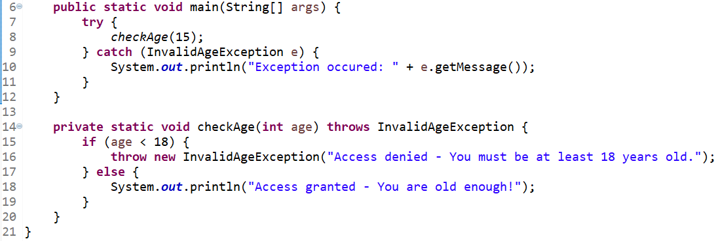
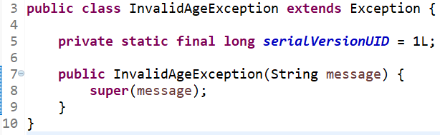
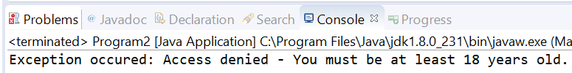
Custom Exception

Slide 21
Assignments 1

Slide 22
Assignments 2
Assignment for Testing System

Slide 23
Q & A
Copyright © VTI Academy All Rights Reserved

